Slide 1


CS1010: Programming Methodology
The Mega Recap
Live Q&A
https://pollev.com/jin

Slide 2

Objectives
Learn about a systematic way to write programs for solving computational problems
Explore various hardware-related topics, such as memory management.
Become proficient with C and associated programming tools (editors, debuggers)
The course is called Programming Methodology.
It is NOT just about coding in C!

Slide 3
The Mega Recap
Algorithmic Problem Solving
Data Structures, Control Structures and Practical Algorithms
Good Coding Habits
Program Analysis
Computer Memory
Syntax of C

Slide 4
Algorithmic Problem Solving
The Problem
The Process
The Techniques

Slide 5
The Problem
Computational Problems
have well-defined inputs, outputs, and constraints
can be solved step-by-step by a computer
Example
Is 1933091 prime?
Find a route from Point A to Point B.
How many different routes are there from Point A to Point B?
Find the shortest route from Point A to Point B.

Slide 6
The Process
Determine problem features
Analysis
Iterative process
Write algorithm
Design
Produce code
Implementation
Check for correctness and efficiency
Testing

Slide 7
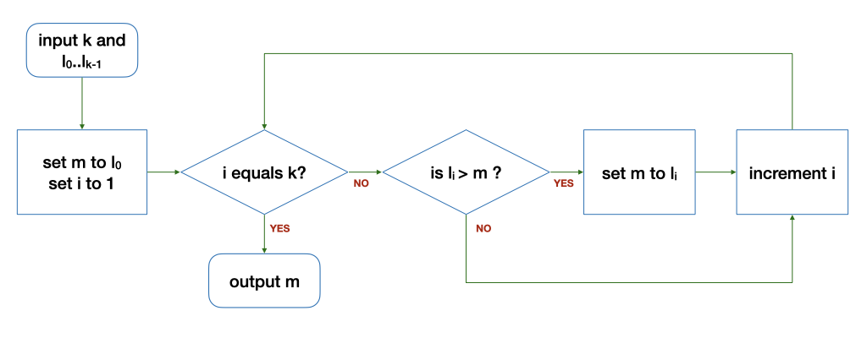
Algorithm: Example
Data + Steps (with Control Structures)
Repetition
Sequence
Selection
Input: 5 9 8 1 3 2
Tracing (Algorithm) is important!
k | i | l_{i} | m | Remark
6 | 1 | 9 | 5 | Before the loop
6 | 2 | 8 | 9 | After 1st round of the loop
6 | 3 | 1 | 9 | After 2nd round…
k | i | l_{i} | m | Remark
6 | 4 | 3 | 9 | After 3rd round…
6 | 5 | 2 | 9 | After 4th round…
6 | 6 | - | 9 | After 5th round…

Slide 8
The Techniques
Problem: Find the range (i.e., max-min) of a list of numbers
Algorithm:
Input: Read in a list L of k numbers (ReadInput)
Compute:
Compute the maximum of a list L of k numbers (FindMax)
Compute the minimum of a list L of k numbers (???)
Compute the difference between the maximum and the minimum (Arithmetic computation)
Output: Print the range (PrintOutput)
1. Breaking it down!
2. Borrowing from what we know!
3. Wishful thinking! (Functions)

Slide 9
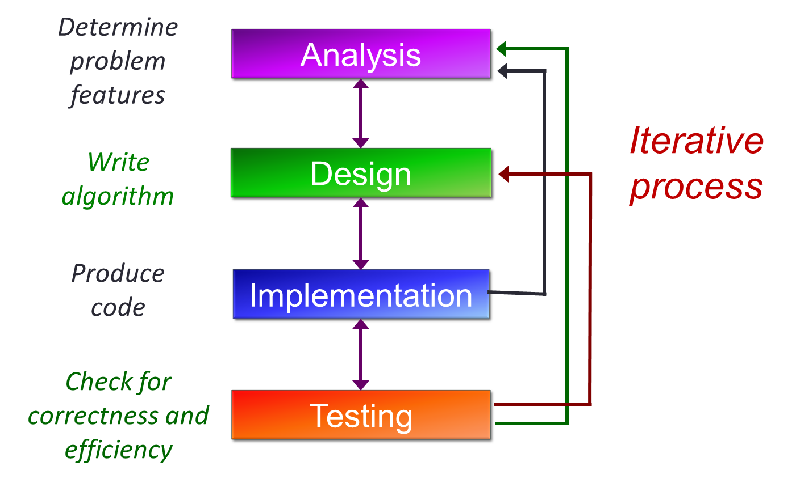
The Process Expanded
Pattern Recognition & Internalization

Slide 10
The Mega Recap
Algorithmic Problem Solving
Data Structures, Control Structures and Practical Algorithms
Good Coding Habits
Program Analysis
Computer Memory
Syntax of C

Slide 11
Data Structures
Types
Basic Data Types
Arrays
Structures
How to…
Declare
Initialize
Access
Pass (into a function)
Update
Allocate & Free

Slide 12
Basic Data Types
For storing single values
Examples
long: 4/8 bytes, signed
char: 1 byte
double: 8 bytes
bool: 1 byte
size_t: 4/8 bytes, unsigned

Slide 13
Array
For storing multiple values of the same type
Declaring and initializing an array.
long days(long month) {
long days_in_month[12] = {31, 28, 31, 30, 31, 30, 31, 31, 30, 31, 30, 31};
if (month == 1) { return 0;}
long days_since = 0;
for (long i = 0; i <= month - 2; i += 1) {
days_since += days_in_month[i];
}
…
}
Iterating through the array.

Slide 14

String
A char array terminated by a null character '\0' (which has the numeric value 0)
char hello1[7] = {'h', 'e', 'l', 'l', 'o', '!', '\0'};
char hello1[7] = {'h', 'e', 'l', 'l', 'o', '!', 0};
These two are the same!
char hello1[7] = {'h', 'e', 'l', 'l', 'o', '!'};
Not a string. Strange errors may occur.
char hello2[7] = "hello!";
char hello3[] = "hello!";
These are ok as well!
hello1[1] = 'v';
Individual elements can be accessed / modified.

Slide 15
Multi-dimensional Arrays
In general, an array can have any number of dimensions
Example of a 2-dimensional (2D) array:
// array with 3 rows, 5 columns
long a[3][5];
a[0][0] = 2;
a[2][4] = 9;
a[1][0] = a[2][4] + 7;
0
1
2
3
4
0
2
1
16
2
9

Slide 16
Structure Type
Write a program to compute the volume of 2 boxes.
// for 1st box
long length1;
long width1;
long height1;
// for 2nd box
long length2;
long width2,
long height2;
length1
width1
height1
length2
width2
height2
More logical to organize the dimensions into a group and declare two variables of such a group.
box1
box2
length
width
height
length
width
height

Slide 17
Structure Type
A structure type is NOT a variable!
It is a data type like long, double except that it is compound.
The following is a definition of a type, NOT a declaration of a variable
A type needs to be defined before we can declare variable of that type
No memory is allocated to a type
typedef struct {
char *code;
char *title;
long mc;
} module_t;

Slide 18
Structure Variables
Initialization
Use dot (.) operator
With compound literal
module_t cs1010;
cs1010.code = "CS1010";
cs1010.title = "Programming Methodology";
cs1010.mc = 4;
Unmentioned components are initialized to 0.
module_t cs1010 = {
.code = "CS1010",
.title = "Programming Methodology",
.mc = 4
};

Slide 19
Control Structures
Types
Sequence
Selection
Repetition
How to …
Decide the correct flow
Write the correct logical expressions

Slide 20
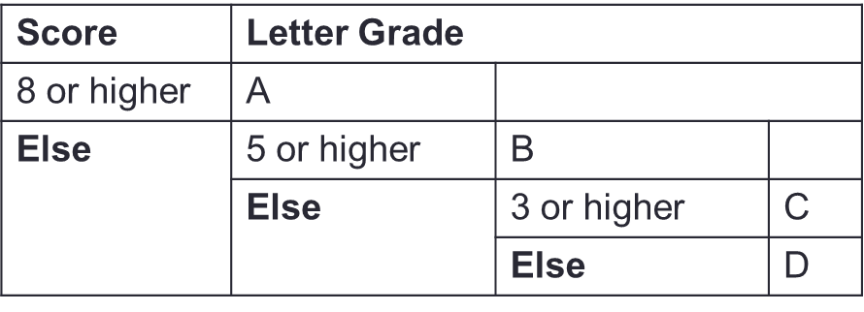
Nested if-else Statements
Problem: Print a letter grade based on a score
…
if (score >= 8) {
// print "A"
} else {
if (score >= 5) {
// print "B"
} else {
if (score >= 3) {
// print "C"
} else {
// print "D"
}
}
}
…
Logical Thinking is important!

Slide 21
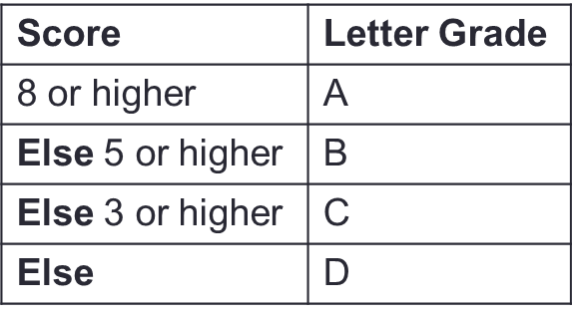
if-(else-if-)else… Statements
Problem: Print a letter grade based on a score
…
if (score >= 8) {
// print "A"
} else if (score >= 5) {
// print "B"
} else if (score >= 3) {
// print "C"
} else {
// print "D"
}
…
Logical Thinking is important!

Slide 22
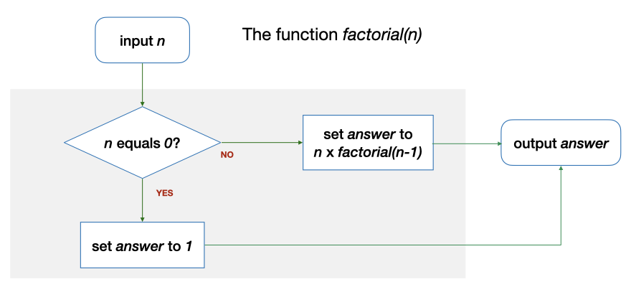
Repetition through Recursion
factorial(2) requires factorial(1), which in turn requires factorial (0)
long factorial(long n) {
long answer;
if (n == 0) {
answer = 1;
} else {
answer = n * factorial(n - 1);
}
return answer;
}

Slide 23
Common Types of Recursion
Integers
Base case: a single digit or 0
Recursive case: number – 1 or number / 10
Example: factorial, sum_digits
1D arrays (including strings)
Base case: an array of 1 element or an empty array
Recursive case: the array minus the first / last element, or left / right half of the elements.
Example: find_max, binary_search
2D arrays
Base case: a single row / column or an empty array
Recursive case: the array minus one row and / or a column

Slide 24
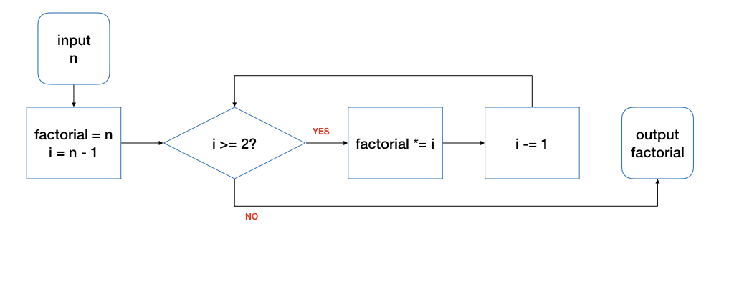
Repetition through Loops
for (long i = n - 1; i >= 2; i -= 1) {
product *= i;
}
Good for repetitions that have an explicit start / end / update.
for ( initialize; condition; update ) {
// loop body
}

Slide 25
Repetition through Loops
long i = n - 1;
while (i >= 2) {
product *= i;
i -= 1;
}
while ( condition ) {
// loop body
}
Good for repetitions that do not have explicit start / end / update.

Slide 26
Repetition through Loops
long i = n - 1;
do {
product *= i;
i -= 1;
} while (i >= 2);
do {
// loop body
} ( condition );
Good for repetitions that must be done at least once.

Slide 27
Practical Algorithms
General algorithms
Find Max
Counting
Lookup Table
Permutation
Logical Checks

Slide 28
Practical Algorithms
Searching & Sorting
Linear and Binary Search
Counting / Selection / Bubble / Insertion Sort
Applications on various Data Structures / Problems

Slide 29
Linear Search
Also known as Sequential Search
Idea: Search the list from one end to the other end in linear progression.
Algorithm:
Example: Search for 24 in this list
// Search for key in list A with n items
linear_search(n, list, q)
{
for i = 0 to n-1
if list_{i} is q then report i
}
87 12 51 9 24 63
no
no
no
no
yes!
Return 4
What to report if key is not found?
Aim for a clean design

Slide 30
Binary Search
Example: Search key = 23
arr
[0]
[1]
[2]
[3]
[4]
[5]
[6]
[7]
[8]
5
12
17
23
38
44
77
84
90
Found!
Return 3
1. start = 0, end = 8, mid = (0+8)/2 = 4
arr[4] = 38 > 23
2. start = 0, end = 3, mid = (0+3)/2 = 1
arr[1] = 12 < 23
3. start = 2, end = 3, mid = (2+3)/2 = 2
arr[2] = 17 < 23
4. start = 3, end = 3, mid = (3+3)/2 = 3
arr[3] = 23 == 23

Slide 31
Counting Sort
in
[1]
[3]
[4]
A list of 6 items in the range of [0, 9]
[0]
[2]
[5]
5
5
3
2
8
2
freq
[1]
[3]
[4]
[9]
[0]
[2]
[5]
[6]
[7]
[8]
10 slots in the freq array.
0
0
2
1
0
2
0
0
1
0
out
[1]
[3]
[4]
[0]
[2]
[5]
2
2
3
5
5
8

Slide 32
Selection Sort
n = 9
max
last
array
[1]
[3]
[4]
[0]
[2]
[5]
[6]
[7]
[8]
1st pass:
23
17
5
90
12
44
38
84
77
max
last
2nd pass:
23
17
5
77
12
44
38
84
90
max
last
3rd pass:
23
17
5
77
12
44
38
84
90
max
last
4th pass:
23
17
5
38
12
44
77
84
90

Slide 33
Bubble Sort: One Pass
0
1
2
3
4
5
6
7
8
23
17
5
90
12
44
38
84
77
17
5
23
12
44
90
38
84
77
exchange
exchange
17
23
5
90
12
44
38
84
77
17
5
23
12
44
38
90
84
77
exchange
exchange
17
5
23
90
12
44
38
84
77
17
5
23
12
44
38
84
90
77
exchange
ok
exchange
17
5
23
12
90
44
38
84
77
17
5
23
12
44
38
84
77
90
exchange
Q: Is the array sorted?
Q: What have we achieved?
Done!

Slide 34
Insertion Sort
Sorted region
a [0] [1] [2] [3] [4]
Pass 1
Pass 2
10
5
7
1
6
Where to insert a[1] in the sorted region to its left?
5
10
7
1
6
5
10
7
1
6
Where to insert a[2] in the sorted region to its left?
5
7
10
1
6

Slide 35
The Mega Recap
Algorithmic Problem Solving
Data Structures, Control Structures and Practical Algorithms
Good Coding Habits
Program Analysis
Computer Memory
Syntax of C

Slide 36
Good Coding Habits
Incremental Coding
Style
Writing Efficient Code

Slide 37
N Queens
Incremental Coding
int main(void){
size_t n = cs1010_read_size_t();
char *queens = malloc((n + 1) * sizeof(char));
free(queens);
}
Focus on the main function.
Compile and test with a small n (e.g., 4).
(No outputs yet.)

Slide 38
N Queens
Incremental Coding
void nqueens(char queens[], size_t n, long row) {
cs1010_println_string(queens);
}
int main(void){
…
queens[0] = 'a';
for (size_t i = 1; i < n; i += 1) {
queens[i] = queens[i-1] + 1;
}
queens[n] = '\0';
nqueens(queens, n, 0);
…
}
Add initialization and placeholder for nqueens.
Compile and test.
(Output should be the default sequence.)

Slide 39
N Queens
Incremental Coding
void swap(char a[], long i, long j) {}
bool threaten_each_other_diagonally(char queens[], size_t len) {
return false;
}
void nqueens(char queens[], size_t n, long row) {
if (row == n-1) {
if (!threaten_each_other_diagonally(queens, n)) {
cs1010_println_string(queens);
}
return;
}
nqueens(queens, n, row + 1);
for (size_t i = row + 1; i < n; i += 1) {
swap(queens, row, i);
nqueens(queens, n, row + 1);
swap(queens, row, i);
}
}
Add in the recursion with placeholders for the additional functions.
Compile and test. (Output should be the default sequence printed many times.)

Slide 40
N Queens
Incremental Coding
void swap(char a[], long i, long j) {
char temp = a[i];
a[i] = a[j];
a[j] = temp;
}
Implement swap
Compile and test. (Output should be all permutations.)
bool has_a_queen_in_diagonal(char queens[], long len, long i){
return false;
}
bool threaten_each_other_diagonally(char queens[], long len) {
for (long i = 0; i < len; i += 1) {
if (has_a_queen_in_diagonal(queens, len, i)) {
return true;
}
}
return false;
}
Implement threaten with placeholder.
Compile and test. (Output should be all permutations.)

Slide 41
N Queens
Incremental Coding
bool has_a_queen_in_diagonal(char queens[], long len, long i) {
char curr_col = queens[i];
char left_col = curr_col - 1;
char right_col = curr_col + 1;
for (long row = i+1; row < len; row += 1) {
if (queens[row] == left_col || queens[row] == right_col) {
return true;
}
left_col -= 1;
right_col += 1;
}
return false;
}
Implement has_a_queen…
Compile and test. (Output should be only the valid permutations.)
Compile and test with all test cases using make.

Slide 42

Style
For making the code neat and readable.
for(i=0;i<3;i+=1){
while(j!=i){cs1010_print_string("Hello\n");}}
for (i = 0; i < 3; i += 1) {
while (j != i) {
cs1010_print_string("Hello\n");
}
}

Slide 43
Documentation
For making the code easy to understand.
/**
* Find the number between 1 and n with the maximum * number of steps to reach 1, breaking ties by finding * the larger among these numbers.
* @param[in,out] max_num_steps The maximum number of steps
* @param[out] max_n The number with the maximum number of steps
*
* @pre max_num_steps <= 0
*/
void solve(long n, long *max_n, long *max_num_steps) {
…
}

Slide 44
Good Habits for Writing Efficient Code
Avoid redundant / repeated work
Use an efficient algorithm as quantified by time complexity (esp. in the worst-case scenario)
for (long i = 2; i != n; i += 1) {
first = second;
second = third;
third = first + second;
}
O(n)
long fib(long n) {
if (n == 1 || n == 2)
return n;
else
return fib(n-1) + fib(n-2);
}
long fib(long n) {
if (n == 1 || n == 2)
return n;
else
return fib(n - 1) + fib(n - 2);
}
O(2^{n})
O(1) < O(log n) < O($\sqrt{n}$) < O(n) < O(n²) < O(n³) < … < O(2^{n}) < O(3^{n})

Slide 45
The Mega Recap
Algorithmic Problem Solving
Data Structures, Control Structures and Practical Algorithms
Good Coding Habits
Program Analysis
Computer Memory
Syntax of C

Slide 46
Program Analysis
Correctness
Tracing (Code)
Assertion / Loop Invariant
Efficiency
Time Complexity

Slide 47
Tracing (Code)
void print_digits(long n) {
long digit;
while (n > 0) {
digit = n%10;
CS1010_print_long(digit);
n /= 10;
}
}
What are the values of n and digit at various point of time?
n: 28943
n | digit | n > 0 | Remark
28943 | - | true | Before the loop
2894 | 3 | true | After the first round…
289 | 4 | true | After the second round…

Slide 48
Assertion
For specifying, understanding, checking of logic.
Problem: Find the maximum value between two variables
((max == x) && (max > y)) || ((max >= x) && (max == y))
if (x > y) {
// { x > y }
max = x;
// {max == x && max > y}
else {
// { x <= y }
max = y;
// {max >= x && max == y}
}
x > y
x <= y

Slide 49
Loop Invariant
An assertion that is true before the loop, after each iteration of the loop, and after the loop.
1
2
3
4
5
6
7
8
9
10
11
12
13
14
15
16
long factorial(long n)
{
if (n == 0) { return 1; }
long product = 1;
long i = 1;
// Line A: before the loop
while (i < n) {
// Line B: beginning of each iteration
i += 1;
// Line C: …
product *= i;
// Line D: after each iteration
}
// Line E: after the loop
return product;
}

Slide 50
Time Complexity Analysis
Focus on the order of growth and the worst-case scenario.
Example
Initial computation: 7n – 12
Drop constants and keep only the term with the highest rate of growth.
Final result: O(n)
for (long i = 2; i != n; i += 1) {
first = second;
second = third;
third = first + second;
}
O(1) < O(log n) < O($\sqrt{n}$) < O(n) < O(n²) < O(n³) < … < O(2^{n}) < O(3^{n})

Slide 51
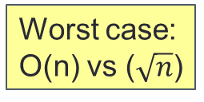
Time Complexity Analysis
Focus on the order of growth and the worst-case scenario.
Example
bool is_prime(long n){
for (long i = 2; i <= n - 1; i += 1) {
if (n % i == 0) {
return false;
}
}
return true;
}
Best case:
Both O(1)
Worst case: O(n) vs ($\sqrt{n}$)
bool is_prime(long n){
for (long i = 2; i <= sqrt(n); i += 1) {
if (n % i == 0) {
return false;
}
}
return true;
}
This is more efficient!

Slide 52
The Mega Recap
Algorithmic Problem Solving
Data Structures, Control Structures and Practical Algorithms
Good Coding Habits
Program Analysis
Computer Memory
Syntax of C

Slide 53
Computer Memory
Memory Address and Pointer
Call Stack and Heap
Call by Reference

Slide 54
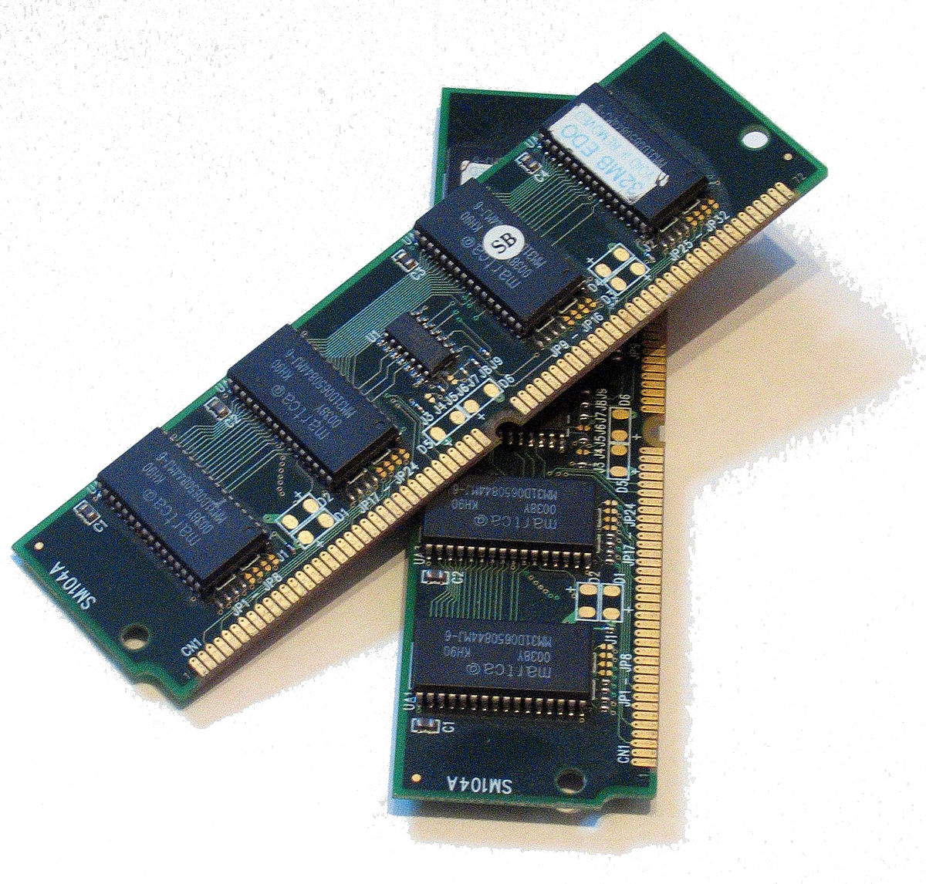
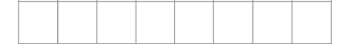
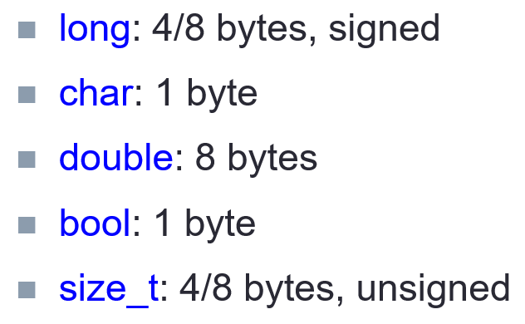
Memory Address
Every location in the memory
Can be used to store 1 byte (i.e., 8 bits) of data
Has an address (i.e., a unique index number).
10001011
1 GB ~= 1 billion byte
…
…
25685528
25685532
What is the address of this location?

Slide 55
Pointers
i
12
j
12
long i = 10, j = 20;
long *p; // p is a pointer to some long variable
10
20
p
p = &i; // p now stores the address of variable i
cs1010_println_long(*p);
Important!
Now *p is equivalent to i
10
// *p accesses the value of pointed/referred variable
*p = *p + 2; // increment *p (which is i) by 2
// same effect as: i = i + 2;
p = &j; // p now stores the address of variable j
Important!
Now *p is equivalent to j
*p = i; // value of *p (which is j now) becomes 12
// same effect as: j = i;

Slide 56
Call Stack
It contains Stack Frames which are
added whenever a function is called
used to store the variables of the function call.
removed when the call is done

Slide 57
Heap
Another region of the memory outside Call Stack
Manual allocation / deallocation
Life-span = from allocation to de-allocation
Bigger in size than the Call Stack
Use case:
Reserve a region for an array whose size depends on the input from the user.

Slide 58
1D Array Allocation / Deallocation
long *array = malloc(10 * sizeof(long));
Need to initialize the array afterwards.
long *array = calloc(10, sizeof(long));
No need to initialize afterwards.
Remember to do this to avoid memory leak!
free(array);

Slide 59
2D Array Allocation / Deallocation
double *buckets[10];
size_t num_of_cols = cs1010_read_size_t();
for (long i = 0; i < 10; i += 1) {
buckets[i] = calloc(num_of_cols, sizeof(double));
}
double **canvas;
size_t num_of_rows = cs1010_read_size_t();
size_t num_of_cols = cs1010_read_size_t();
canvas = calloc(num_of_rows, sizeof(double *));
for (size_t i = 0; i < num_of_rows; i += 1) {
canvas[i] = calloc(num_of_cols, sizeof(double));
}

Slide 60
Call by Reference
Problem: … Print the number with the largest total stopping time and its corresponding total stopping time.
void find_max_steps(long n, long *max_n, long *max_num_steps);
int main() {
long n = cs1010_read_long();
long max_num_steps;
long max_n;
find_max_steps(n, &max_n, &max_num_steps);
cs1010_println_long(max_n);
cs1010_println_long(max_num_steps);
}

Slide 61
Call by Reference
void find_max_steps(long n, long *max_n, long *max_num_steps) {
*max_num_steps = 0;
*max_n = 1;
for (long i = 1; i <= n; i += 1) {
long num_of_steps = count_num_of_steps(i);
if (num_of_steps >= *max_num_steps) {
*max_n = i;
*max_num_steps = num_of_steps;
}
}
}
Alternatives: Return a structure / array

Slide 62
Call by Reference
void update_mc(struct module *cs1010, long hours_spent_per_week) {
(*cs1010).mc = hours_spent_per_week/2.5;
}
More efficient and allow changes to be visible outside.
cs1010->mc = hours_spent_per_week/2.5;
Using the arrow operator as a shorthand.

Slide 63
Call by Reference
Example: long a[10]
a[0]
a[1]
a[2]
a[3]
a[4]
a[5]
a[6]
a[7]
a[8]
a[9]
When the array name a appears in an expression, it refers to the address of the first element (i.e. &a[0]) of that array (a.k.a., Array Decay)
These 2 outputs will always be the same.
long a[3];
cs1010_println_long((long)a);
cs1010_println_long((long)&a[0]);
cs1010_println_long((long)&a[1]);
ffbff724
ffbff724
ffbff732

Slide 64
Function Definition / Call with Array
…
int main(void) {
long foo[4] = {44, 9, 17, 1};
doubleArray(foo, 4);
return 0;
}
void doubleArray(long list[], long len) {
for (long i = 0; i < len; i++){
list[i] *= 2;
}
}
In main():
foo[0]
foo[1]
44
9
17
1
88
18
34
2
What happens if doubleArray(foo, 3) is called instead?
In doubleArray():
list
length
i
?
2
0
1
4
4
3

Slide 65
The Mega Recap
Algorithmic Problem Solving
Data Structures, Control Structures and Practical Algorithms
Good Coding Habits
Program Analysis
Computer Memory
Syntax of C

Slide 66
Syntax of C
How to write Arithmetic Computations / Control Structures?
How to declare, and use Data Structures / Pointers / Functions?
How to manage Memory?
How to use C Library Functions for Math, Characters and Strings and Standard I/O?

